Slide 1
IBM University Engagement Project Submission
“Exploring the Power of Agentic AI with IBM Granite and IBM Bob”

Slide 2

Project Tile – Sequential Task Agent – Investment Analyst
Domain of Project – Education
Student Name | Recent Passport Photo | Email ID | Mobile number [WhatsApp]
Vishwanath Mohan Hadimani |  | vishu.hadimani12@gmail.com | 9886195511
Recommended font style and size:
Font Style: Arial
Font Size (Heading): 28
Font Size (Content): 20

Slide 3
Problem Statement -
The Challenge Investment analysts need to process multiple layers of information—financial reports, stock performance data, market news, and analyst opinions. Much of this information is fragmented and requires a sequence of tasks (data gathering, validation, analysis, comparison, and reporting) to generate useful insights. Manual workflows are time-consuming and prone to errors. The challenge is not just to collect market data but to automate sequential tasks that lead to actionable investment recommendations. The Objective Build a Sequential Task Agent that acts as an intelligent investment analyst.
The solution should:
Automate Data Gathering: Collect financial data from multiple trusted sources such as company reports, stock exchanges, and market news feeds.
Perform Multi-Step Analysis: Sequentially process data (e.g., extract KPIs → calculate financial ratios → benchmark against competitors → analyze market sentiment).
Generate Predictive Insights: Identify trends, detect risks, and provide forward-looking recommendations (e.g., “Stock X shows declining margins—consider underweighting in portfolio”).
Deliver Structured Reports: Provide an easy-to-understand dashboard with investment summaries, trend charts, risk indicators, and AI-generated recommendations

Slide 4
Proposed Solution -
Proposed Solution: AI-Powered Sequential Task Agent – Investment Analyst
The proposed solution is an AI-powered Sequential Task Agent built using Python, Streamlit, Groq API, and the GPT-OSS-120B model to automate investment analysis and generate structured financial insights.
The system works through a sequence of intelligent agents:
Data Gathering Agent: Collects real-time stock prices, financial statements, and company information from trusted sources.
Financial Analysis Agent: Extracts KPIs and calculates important financial ratios such as ROE, ROA, P/E, and Debt-to-Equity.
Competitor Benchmark Agent: Compares the selected company with industry competitors using key financial metrics.
Market Sentiment Agent: Analyzes recent market news and classifies sentiment as positive, neutral, or negative using AI.
Trend & Risk Analysis Agent: Identifies stock trends, technical indicators, and potential investment risks.
AI Recommendation Agent: Generates personalized investment insights and recommendations based on the complete analysis.
The solution includes a Streamlit dashboard with interactive charts, KPI cards, sentiment analysis, risk indicators, and a downloadable AI-generated investment report, providing investors with quick, data-driven decision support.

Slide 5
Technology Used
- Groq API (GPT-OSS-120B): For AI-powered financial analysis, market sentiment analysis, reasoning, and generating investment recommendations.
- Python: Core programming language used to build the Sequential Task Agent and process financial data.
- Streamlit: For building an interactive dashboard to display stock trends, KPIs, risk indicators, and AI-generated investment reports.
- Yahoo Finance API (yfinance): For fetching real-time stock prices, company financial statements, and market data.
- News API / RSS Feeds: For collecting the latest financial news and performing market sentiment analysis.
- RAG (Retrieval-Augmented Generation): Fetches real financial and news data first, then uses AI to generate accurate, context-aware investment insights.
- Vector Database (FAISS/Chroma): Stores and retrieves financial documents, company reports, and news embeddings for RAG-based analysis.
- Plotly & Pandas: For data processing and creating interactive financial charts and competitor comparison visualizations.

Slide 6
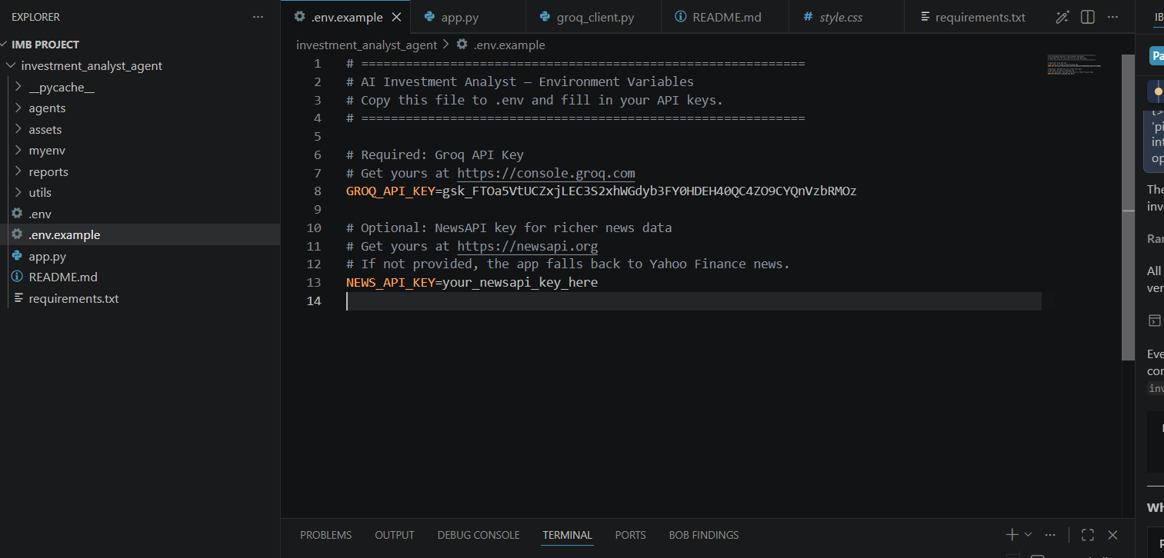
Required Files created using IBM bob -
App.py
Requirements.txt
Style.css
.env.example

Slide 7
IBM Bob Screenshots:

Slide 8
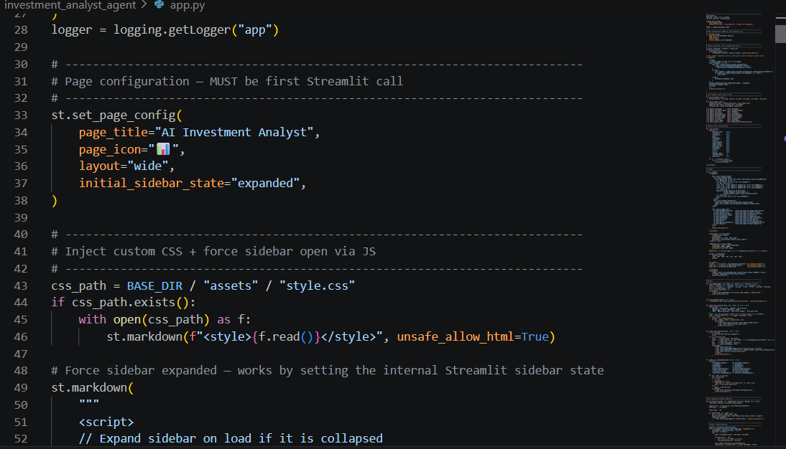

Slide 9
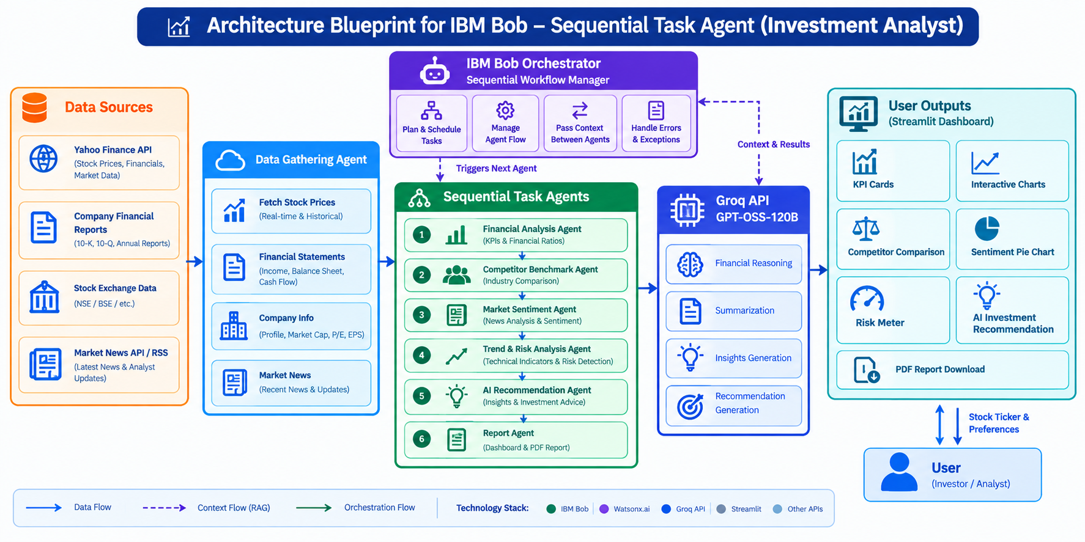
Architecture blueprint for IBM bob:

Slide 10

Role of Agentic AI in the solution
Agentic AI enables the Investment Analyst to function as an intelligent, autonomous system rather than a simple stock information chatbot. Using the Groq API (GPT-OSS-120B), it coordinates multiple specialized agents to perform sequential financial analysis and generate investment insights.
Each agent has a specific role—such as collecting financial data, analyzing KPIs, comparing competitors, evaluating market sentiment, detecting risks, and generating AI-powered recommendations. This multi-agent approach ensures accurate, efficient, and step-by-step investment analysis.
Agentic AI also provides context-aware analysis by understanding the selected company, industry, market trends, and financial performance before generating recommendations. It supports real-time adaptation by updating insights whenever new stock prices, financial reports, or market news become available.
Additionally, the agents communicate with one another, allowing the output of one analysis stage to become the input for the next, resulting in more informed investment decisions.
Overall, Agentic AI makes the system proactive, data-driven, and goal-oriented, acting like a smart digital investment analyst that helps users understand financial performance, identify risks, and make informed investment decisions.
.

Slide 11
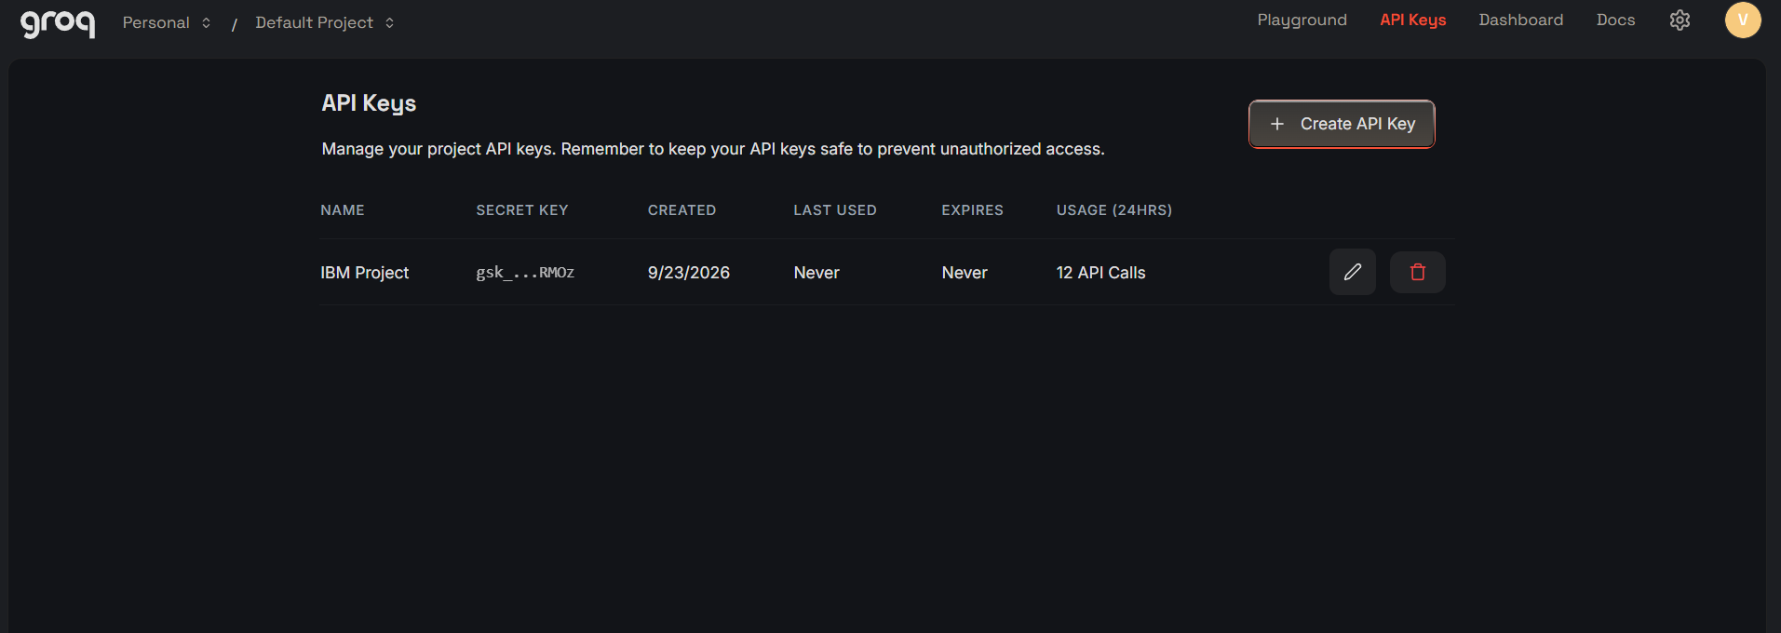
Token Usage
12 API Calls
·
·
·

Slide 12
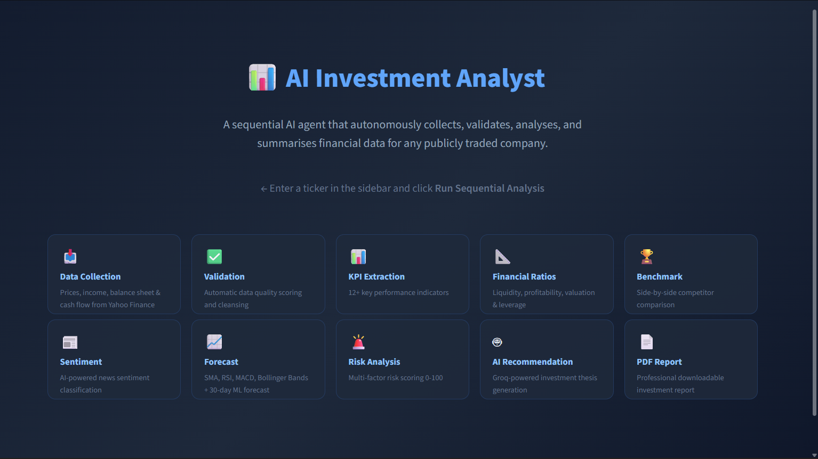
Project Output Screenshot
·
·
·

Slide 13
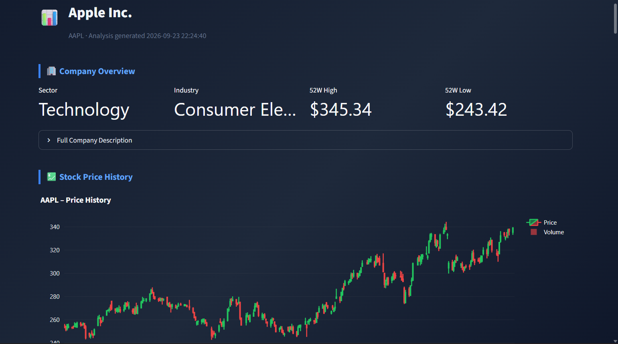
Project Output Screenshot
·
·
·

Slide 14
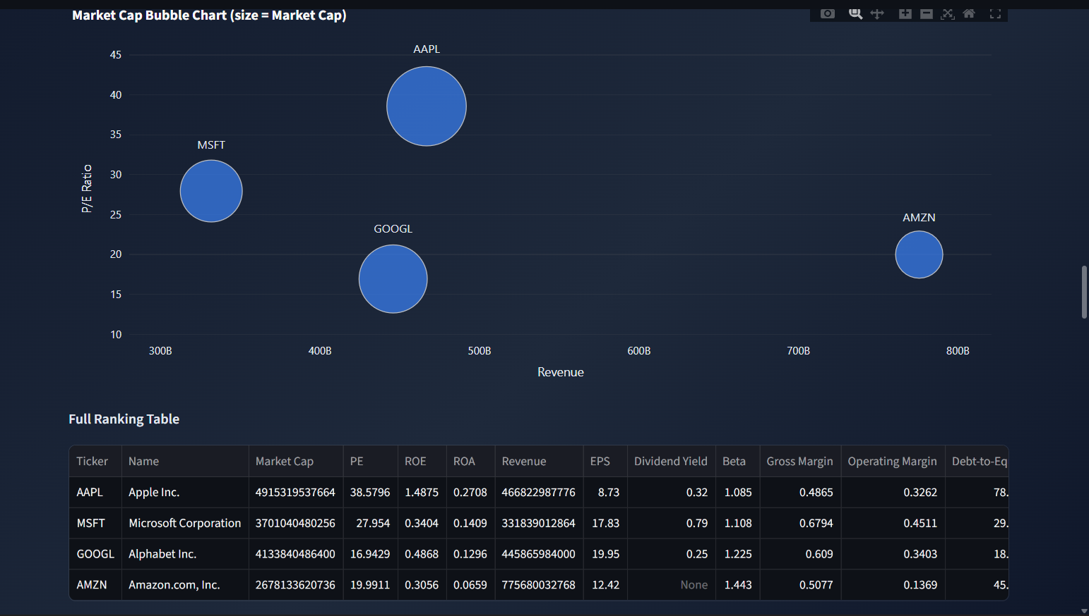
Project Output Screenshot
·
·
·

Slide 15
Novelty and Uniqueness
Uniqueness of the Proposed Solution
The Sequential Task Agent – Investment Analyst stands out by combining Agentic AI, RAG, and real-time financial analysis into one intelligent system.
Multi-Agent Intelligence: Specialized agents perform data collection, KPI analysis, competitor benchmarking, sentiment analysis, risk detection, and recommendations.
RAG-Based Accuracy: Retrieves real-time financial reports and market news before generating AI insights.
Context-Aware Analysis: Provides personalized investment insights based on company performance and market conditions.
Real-Time Updates: Continuously analyzes live stock prices and news sentiment.
Interactive Dashboard: Displays KPIs, charts, risk indicators, and AI-generated investment reports in Streamlit.
This makes the solution a smart, data-driven, and proactive digital investment analyst.

Slide 16
Git Hub Link
· Github URL –https://github.com/vishuhadimani12-hash/Sequential-Task-Agent-Investment-Analyst-.git
·
·
·

Slide 17
Future Scope
1. Integration with Real-Time Financial APIs
The system can be integrated with live financial APIs such as Yahoo Finance, Alpha Vantage, and stock exchange APIs to fetch real-time stock prices, company financial reports, and market news for more accurate investment analysis.
2. AI-Powered Voice Assistant & Multilingual Support
Adding a voice-enabled assistant and multilingual support will allow users to interact with the Investment Analyst in their preferred language, making the application more accessible and user-friendly for a wider audience.
·
·
·

Slide 18
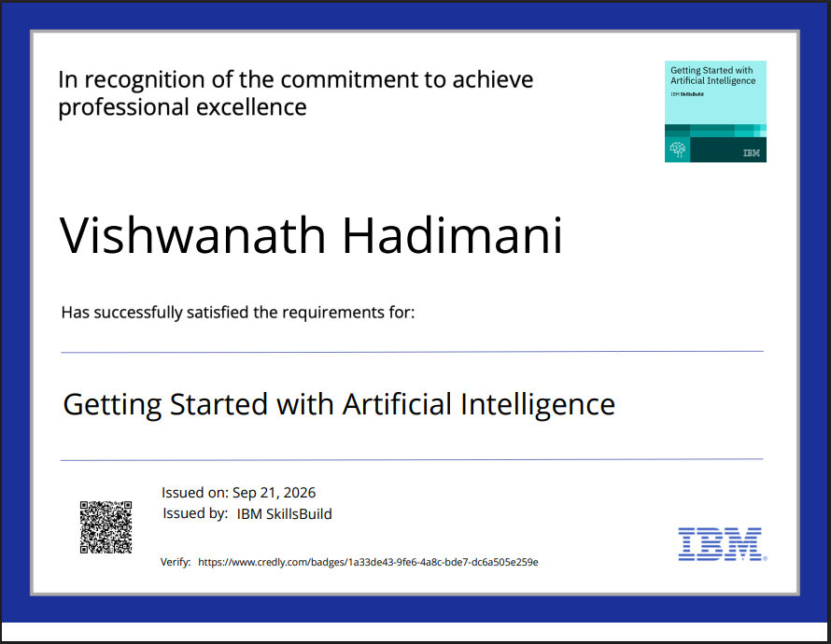
Certificates Earned:

Slide 19
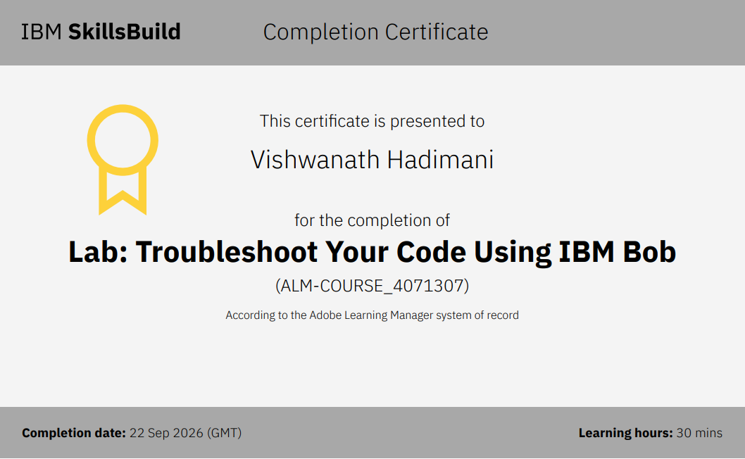
Certificates Earned:​

Slide 20


